Slide 1
9.1 – Translate Figures and Use Vectors

Slide 2
Transformation:
Moves or changes a figure
Preimage:
Original figure
Image:
Transformed figure
“P prime”
Isometry:
A congruent transformation

Slide 3
Translation:
An isometry that moves every point a certain distance in a certain direction
P
Q

Slide 4
Translation:
Note:
and

Slide 5
Motion Rule:
Moves each point left, right, down, or up
Left
or
Right
Down
or
Up

Slide 6
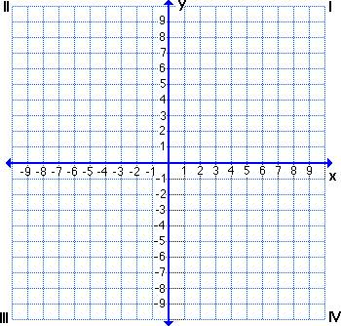
Use the translation
What is the image of D(4, 7)?
(4 + 2, 7 – 5)
D
+2
–5
(6, 2)

Slide 8
Use the translation
What is the image of R(2, –4)?
(2 – 7, –4 + 4)
(–5, 0)
+4
–7
R

Slide 9
Δ is the image of ΔABC after a translation. Write a rule for the translation.
+3
–5

Slide 10
Δ is the image of ΔABC after a translation. Write a rule for the translation.
+2
–5

Slide 11
Vector:
Translates a shape in direction and magnitude, or size.
Name:
FG
Where F is the initial point and G is the terminal point.
Component form:

Slide 12
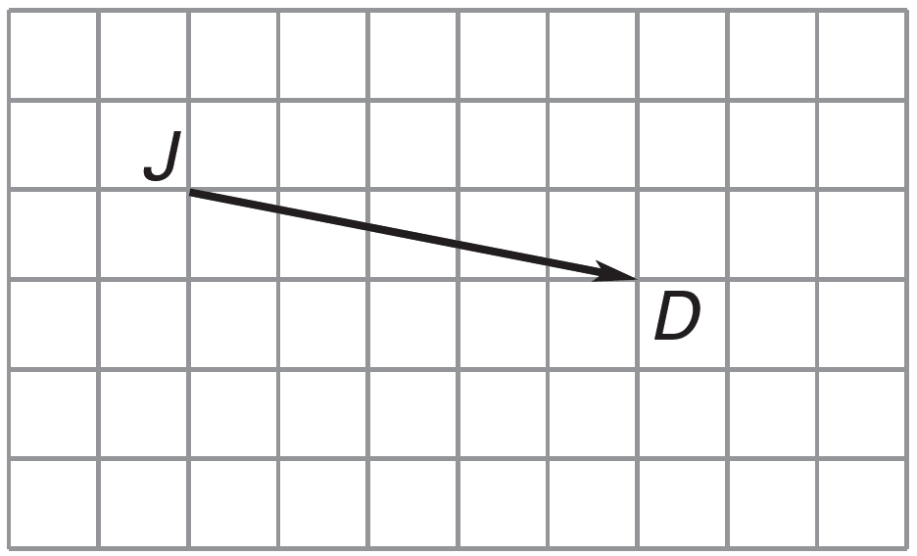
Name the vector and write its component form.
+5
–1
JD
Vector Name: _____________
Component Form: _________

Slide 13
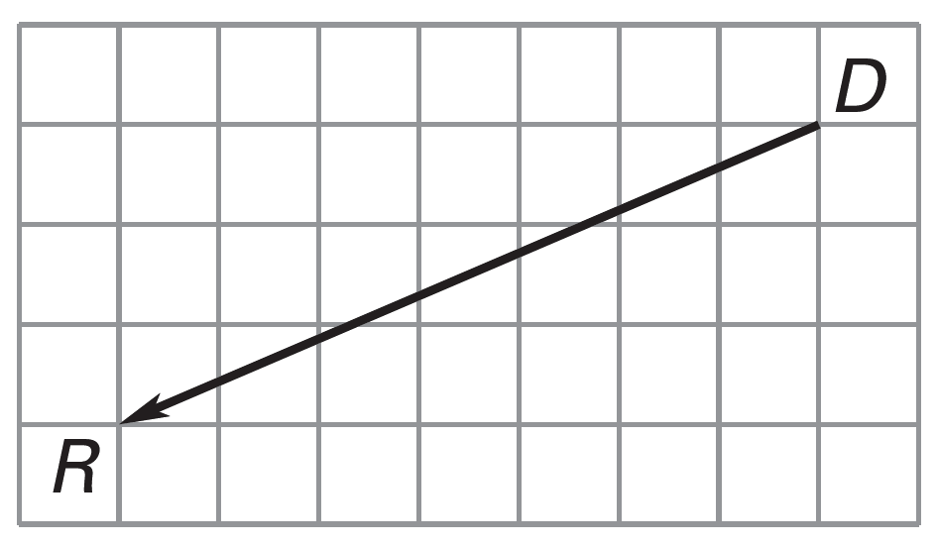
Name the vector and write its component form.
–7
–3
DR
Vector Name: _____________
Component Form: _________

Slide 14
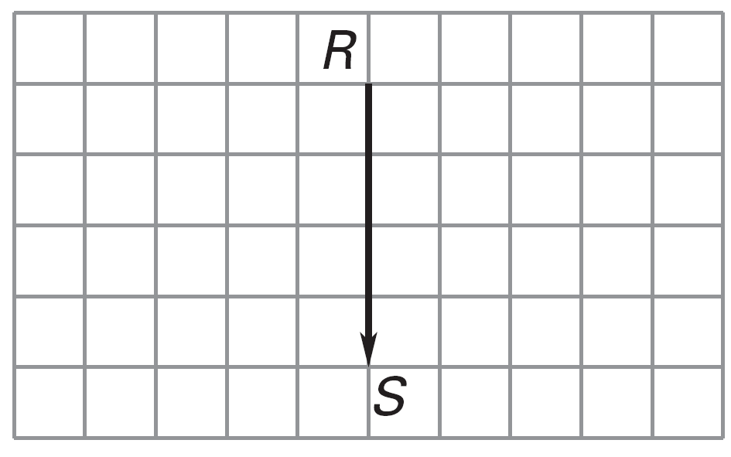
Name the vector and write its component form.
–4
RS
Vector Name: _____________
Component Form: _________

Slide 15
is the image of ΔABC after a translation. Write a vector in component form for the translation.
+2
–5
Component Form: _________

Slide 16
is the image of ΔABC after a translation. Write a vector in component form for the translation.
C
B
+2
–4
A
Component Form: _________

Slide 17
Find the value of each variable in the translation.
a =
80°
2b = 8
b = 4
c = 13
5d = 100
d = 20°

Slide 18
Find the value of each variable in the translation.
b – 5 = 12
b = 17
3c + 2 = 20
3c = 18
c = 6
a =
180 – 90 – 31
a = 59°

