Slide 1
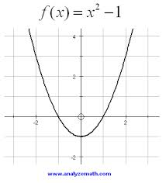
2.2 – Limit of a Function and Limit Laws
Defn: Limit
As the variable x approaches a certain value, the variable y approaches a certain value.
$$\lim_{x→c}{f\left(x\right)=L}$$
Find the requested limits from the graph of the given function.
$$\lim_{x→0}{f\left(x\right)=}$$
$$−1$$
$$\lim_{x→1}{f\left(x\right)=}$$
$$0$$
$$\lim_{x→−1}{f\left(x\right)=}$$
$$0$$
$$\lim_{x→2}{f\left(x\right)=}$$
$$3$$
$$\lim_{x→−2}{f\left(x\right)=}$$
$$3$$

Slide 2
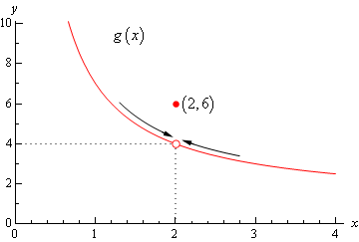
2.2 – Limit of a Function and Limit Laws
$$\lim_{x→c}{f\left(x\right)=L}$$
Given the following graph of a function, find the requested limit.
$$\lim_{x→2}{g\left(x\right)=}$$
$$4$$
$$g\left(2\right)=$$
$$6$$
$$\left(2,6\right)$$

Slide 3
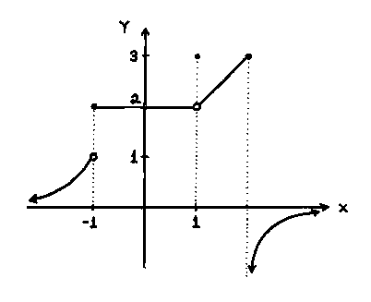
2.2 – Limit of a Function and Limit Laws
$$\lim_{x→c}{f\left(x\right)=L}$$
Given the following graph of a function, find the requested limits.
$$\lim_{x→0}{f\left(x\right)=}$$
$$2$$
$$f\left(0\right)=$$
$$2$$
$$\left(0,2\right)$$
$$\lim_{x→−1}{f\left(x\right)=}$$
$$jump$$
$$f\left(−1\right)=$$
$$2$$
$$\left(−1,2\right)$$
$$\lim_{x→1}{f\left(x\right)=}$$
$$2$$
$$f\left(1\right)=$$
$$3$$
$$\left(1,3\right)$$
$$\lim_{x→2}{f\left(x\right)=}$$
$$jump$$
$$f\left(2\right)=$$
$$3$$
$$\left(2,3\right)$$

Slide 4
2.2 – Limit of a Function and Limit Laws
Find the requested limits for the given function.
$$f\left(x\right)=x^{2}−1$$
$$\lim_{x→0}{f\left(x\right)=}$$
$${\left(0\right)}^{2}−1=$$
$$−1$$
$$\lim_{x→2}{f\left(x\right)=}$$
$${\left(2\right)}^{2}−1=$$
$$3$$
$$\lim_{x→1}{f\left(x\right)=}$$
$${\left(1\right)}^{2}−1=$$
$$0$$
$$\lim_{x→−2}{f\left(x\right)=}$$
$${\left(−2\right)}^{2}−1=$$
$$3$$
$$\lim_{x→−1}{f\left(x\right)=}$$
$${\left(−1\right)}^{2}−1=$$
$$0$$

Slide 5
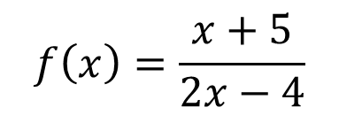
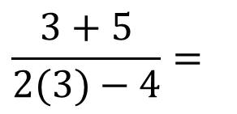
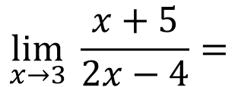
2.2 – Limit of a Function and Limit Laws
A rational function is the ratio of two polynomial functions
$$f\left(x\right)=\frac{x+5}{2x−4}$$
$$\lim_{x→3}{\frac{x+5}{2x−4}=}$$
$$\frac{3+5}{2(3)−4}=$$
$$\frac{8}{2}=$$
$$4$$
Substitution Theorem:
If f(x) is a polynomial function or a rational function, then
$\lim_{x→c}{f(x)}=f(c)$ or $\lim_{x→c}{\frac{k(x)}{g(x)}}=\frac{k(c)}{g(c)}$.
If f(x) is a rational function, then the denominator cannot equal zero.

Slide 6
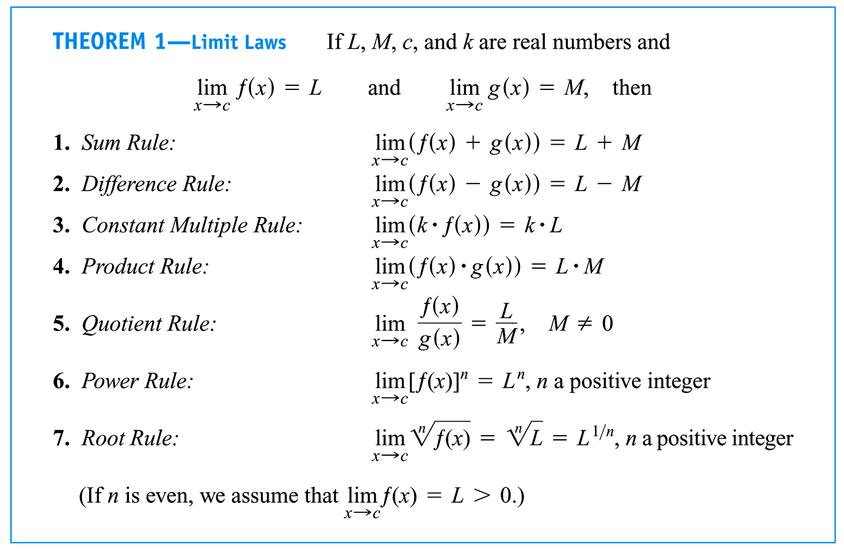
2.2 – Limit of a Function and Limit Laws

Slide 7
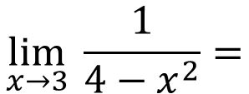
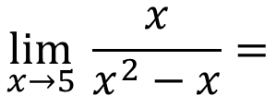
2.2 – Limit of a Function and Limit Laws
Find the following limits:
$$\lim_{x→3}{\frac{1}{4−x^{2}}=}$$
$$−\frac{1}{5}$$
$$\lim_{x→5}{\frac{x}{x^{2}−x}=}$$
$$\frac{1}{4}$$
$$\lim_{x→−4}{\frac{x−6}{x^{2}−36}=}$$
$$\frac{1}{2}$$
$$\lim_{x→6}{\frac{x+2}{x^{2}+x−10}=}$$
$$\frac{1}{4}$$

Slide 8
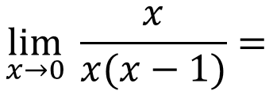
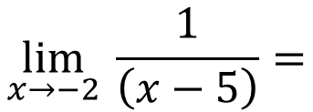
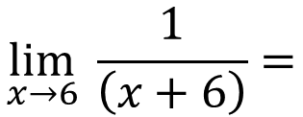
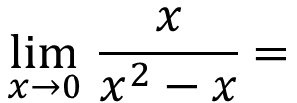
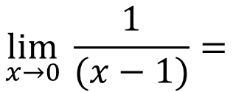
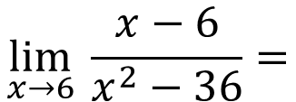
2.2 – Limit of a Function and Limit Laws
Find the following limits:
$$\lim_{x→0}{\frac{x}{x^{2}−x}=}$$
$$\lim_{x→0}{\frac{x}{x(x−1)}=}$$
$$\lim_{x→0}{\frac{1}{(x−1)}=}$$
$$−1$$
$$\lim_{x→6}{\frac{x−6}{x^{2}−36}=}$$
$$\lim_{x→6}{\frac{x−6}{\left(x+6\right)\left(x−6\right)}=}$$
$$\lim_{x→6}{\frac{1}{\left(x+6\right)}=}$$
$$\frac{1}{12}$$
$$\lim_{x→−2}{\frac{x+2}{x^{2}−3x−10}=}$$
$$\lim_{x→−2}{\frac{x+2}{\left(x+2\right)\left(x−5\right)}=}$$
$$\lim_{x→−2}{\frac{1}{\left(x−5\right)}=}$$
$$−\frac{1}{7}$$

